Slide 1

Entra ID Governance technical training for services partners

Slide 2







Microsoft Entra: Secure access for a connected world
Every Identity | Every Resource | Everywhere
Human identities
Data
Workload identities
Granular access policies
Global scale and resilience
SaaS apps
Customers
Cloud-hosted apps
and resources
Amazon Web Services
Partners
Microsoft Azure
Google Cloud
ML, AI, Automation
Unified Experience
On-premises applications
Devices
Websites
Powered by trillions of security signals
Notes:
Talk Track
To that end, Microsoft is evolving its identity vision to respond to today’s challenges. Microsoft started in 2000 with the Microsoft-only Directory services. That evolved as the world of computing and security evolved. In 2015, Microsoft presented the Access control plane in response to advances in cloud computing. Now, Microsoft thinks of security and identity as a Trust Fabric—a means of providing identity services to everyone and every ‘smart’ thing on the planet.
With a holistic secure-access solution across identities, endpoints, resources, and networks, organizations can eliminate access policy gaps and configuration issues that strain the performance of traditional approaches to network access. Protect any identity and secure access to any resource—on-premises, across clouds, and anywhere in between.

Slide 3
Azure AD is becoming Microsoft Entra ID.
New name.
Same capabilities.
Same licensing.
No customer action is needed.

Slide 4
Azure AD is becoming Microsoft Entra ID.
from…
to…
Azure AD Free
Microsoft Entra ID Free
Azure AD Premium P1
Also included in Microsoft 365 E3
Microsoft Entra ID P1
Also included in Microsoft 365 E3
Azure AD Premium P2
Also included in Microsoft 365 E5
Microsoft Entra ID P2
Also included in Microsoft 365 E5
Azure AD External Identities
Microsoft Entra External ID

Slide 5


Detailed naming guidance available on Microsoft Learn
Azure Active Directory
Microsoft Entra ID
Azure AD Conditional Access
Microsoft Entra Conditional Access
Azure AD accounts
Microsoft Entra accounts
Azure AD joined
Microsoft Entra joined
Azure AD tenant
Microsoft Entra tenant

Slide 6
Microsoft Entra Product Family
Identity & access management
New Identity categories
Network Access
Microsoft Entra ID
Formerly Azure AD
Microsoft Entra Verified ID
Microsoft Entra Internet Access
Microsoft Entra ID Governance
Microsoft Entra Permissions Management
Microsoft Entra Private Access
Microsoft Entra External ID Formerly Azure AD External Identities
Microsoft Entra Workload ID
Notes:
Talk Track
We deliver our expanded vision for identity and access through the Microsoft Entra product family.
The Microsoft Entra product family is made up of:
Microsoft Entra ID (formerly Azure Active Directory, or Azure AD)
Safeguard your organization with an identity and access management solution that connects people to their apps, devices, and data. It's all the same functionality you had before, just with an upgraded name change.
Microsoft Entra ID Governance is a complete identity governance solution that helps you comply with organizational and regulatory requirements while increasing employee productivity through real-time, self-service, and workflow-based app entitlements. It automates the employee identity lifecycle to reduce manual work for IT and provides AI-based insights regarding identities and app entitlements. Because it’s cloud-delivered, Entra Identity Governance scales to complex cloud and hybrid environments, unlike traditional on-premises identity governance point solutions. It supports cloud and on-premises apps from Microsoft and other app providers.
Microsoft Entra External ID is an integrated platform for authenticating external users—including customers, patients, citizens, guests, partners, and suppliers—into applications. This cloud-agnostic, developer-friendly platform offers rich customization options for sign in/up experiences, conditional access identity protection, and support for social identity providers. It uses Azure’s extensive security and compliance features to create secure environments for end users. As part of the Microsoft Entra family technology solutions, External ID includes a comprehensive set of integrated identity capabilities.
Microsoft Entra Verified ID
Create, issue, and verify privacy-respecting decentralized identity credentials with an identity verification solution that helps you enable more secure interactions with anyone or anything.
Microsoft Entra Permissions Management
Discover, remediate, and monitor permission risks across your multicloud infrastructure with a cloud infrastructure entitlement management (CIEM) solution.
Microsoft Entra Workload ID
Secure access, detect risks, and manage identities for apps and services with this industry-leading solution.
Network Access is a new offering and is currently (as of 5/1/2023) in public preview. Now that hybrid remote work is the new normal and cloud workloads are increasing, it’s time to re-think access management. Traditional approaches to network access have led to complex and inconsistent access controls, security gaps, and poor user experiences. We believe identity controls and network controls should work together so that no administrator must manage multiple policies to protect identities and resources. That’s why Microsoft Entra is reinventing secure access by converging Conditional Access controls across identities, endpoints, resources, and networks. With a holistic secure access solution, organizations can eliminate access policy gaps and configuration issues that strain the performance of traditional approaches to network access. Within Network Access are two products: Microsoft Entra Internet Access and Microsoft Entra Private Access.
Microsoft Entra Internet Access
Deliver secure, fast, and identity-centric access to all internet apps and resources for your hybrid workforce while maintaining Zero Trust principles.
Microsoft Entra Private Access
Quickly and securely connect remote users from any device and network to private apps on-premises, across clouds, and anywhere in between.

Slide 7
Agenda
Overview of Microsoft Entra ID Governance SKU
Scenario deep dive
Employee Lifecycle
Govern Access to Resources
Govern External Identities

Slide 8
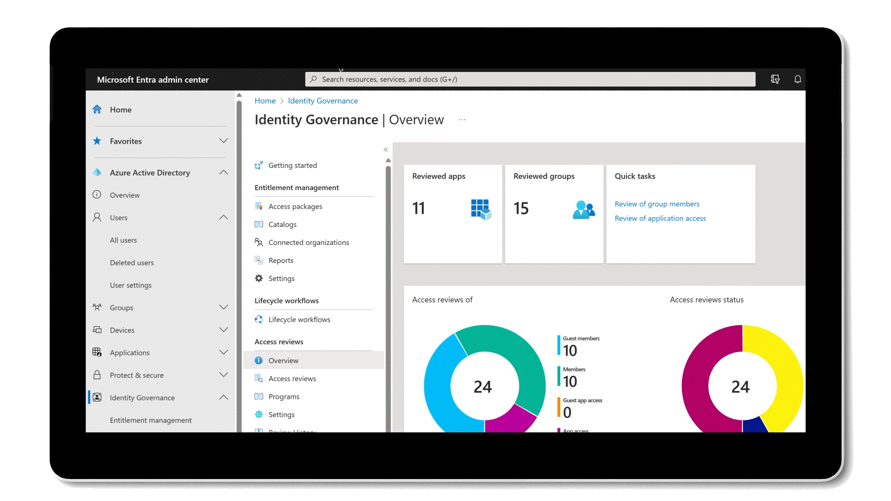


Microsoft Entra ID Governance
Market Challenge
Ensuring that the right people have the right access to the right resources, at the right time.
Managing user identities, access rights, and entitlements across IT environments to ensure proper access controls, mitigate risk, and maintain compliance with regulatory requirements.
Improve Productivity
Strengthen Security
Automate routine tasks

Slide 9




















Contoso’s user journey
Lifecycle Automation
Access recertification
to reduce risk
Self-Service access request when additional access is needed
Onboard the user into the directory when the user joins or start working with Contoso
Teams sites
SharePoint Libraries
Automate the granting of access rights to resources
Make sure access rights are removed when user leaves or stops working with Contoso
SaaS apps & groups
Just-in-time access, alerts, and approval workflows to protect access to critical resources
On-premises apps
Ongoing auditing & reporting

Slide 10
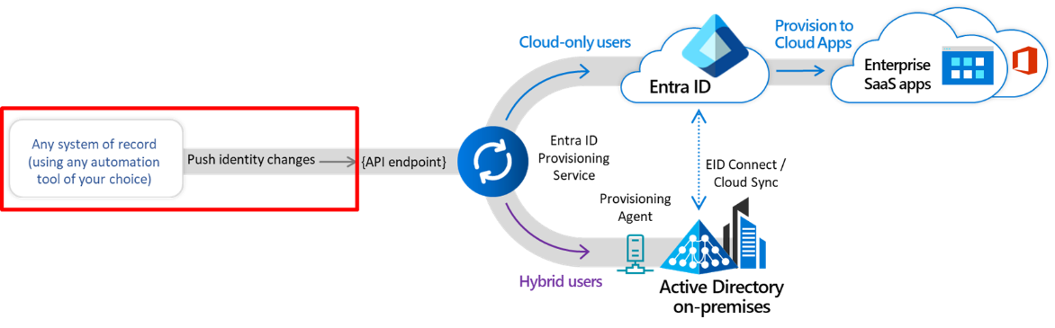
Generic Inbound Provisioning API
PUBLIC PREVIEW
GENERALLY AVAILABLE
PUBLIC PREVIEW
Key benefits
Connect Entra ID tenant to *any* authoritative system of record for inbound identity provisioning.
This system of record could be an HR app like UltiPro, a payroll app like ADP, a spreadsheet in Google Cloud or an on-premises Oracle database.
Decouples HR data export from how data is cleansed before import into Entra ID.
IT admins retain control on identity data flow, transformations and mapping.

Slide 11




Provisioning to on-premises applications
Users and schema defined in the cloud
Supports provisioning from custom schema extensions to app-specific properties.
Single sign-on and provisioning
SCIM
Translation to the provisioning protocols expected by apps
Microsoft-delivered connectors: LDAP, SQL, etc.
Ecosystem of third-party connectors for other apps requiring custom API integrations
Customers can re-use their existing MIM configuration
Entra ID
provisioning agents
SOAP
LDAP
PS
SQL

Slide 12







Lifecycle Workflows
Automate join/move/leave employee lifecycle events
Launch pre-hire workflow
Customers can schedule tasks to occur before, at or after a join or leave date.
Built-in tasks include generating temporary credentials, sending emails, updating user attributes, and memberships, and removing licenses.
Customers and partners can extend lifecycle workflows with additional tasks via Azure Logic Apps.
Launch termination workflow
New worker joins
Worker separates from org
HR Systems
Microsoft Entra ID Governance
Enterprise SaaS apps
Active Directory
on-premises
On-premises apps

Slide 13




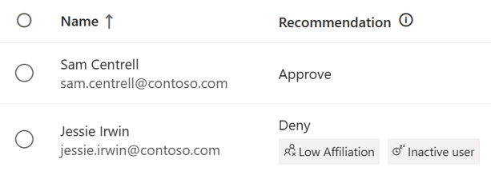



Machine Learning based recommendations in Access Reviews
User-to-Group Affiliation
Machine Learning uses organizational distance to calculate group affiliation
Reviewers get data driven recommendations based on last sign in date and group affiliation
Admins create Access Review to protect against breaches and stay compliant
Last sign in activity
Sam Centrell
18 days
Jessie Irwin
125 days
Inactive user recommendation considers activity based on last sign in date

Slide 14

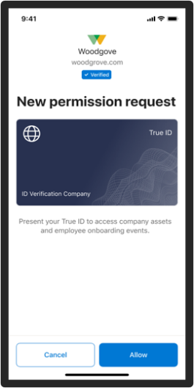
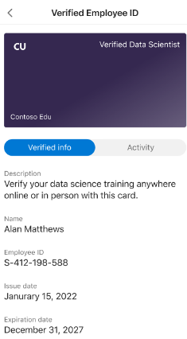
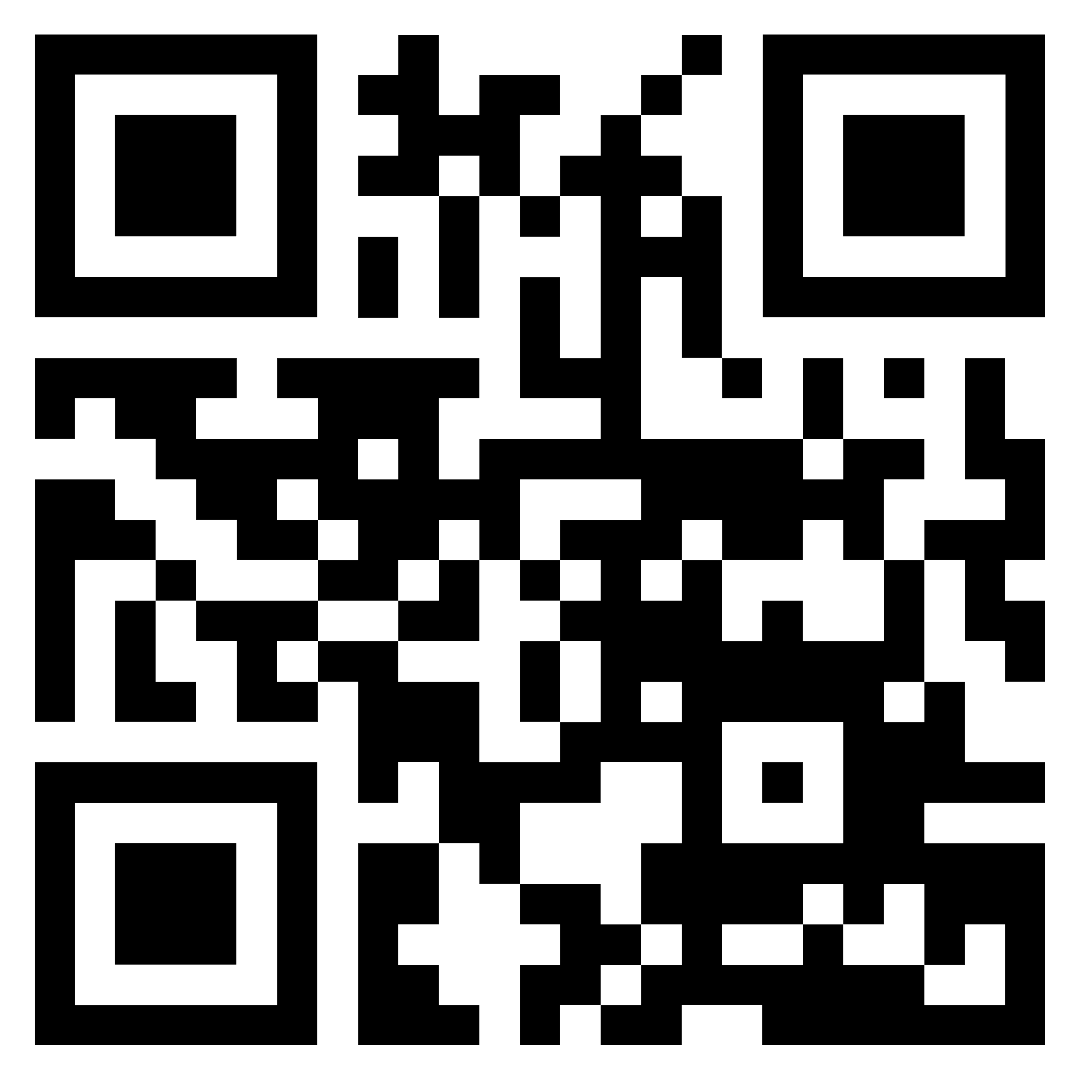
Access requests for users with decentralized IDs
Entitlement Management with verifiable credentials
Reduces need for self-attestation by business partners. Users requesting access will be able to obtain identity attributes from a wide set of issuers.
Scan the QR code below to submit your Verified Identity.
Simplifies approval processes, as approvers do not need to vet requestor’s authenticity of claims.
Simplifies compliance posture with reduced need for manual validation.
Example of better together Microsoft Entra combinations; others include ID Governance + Workload IDs, ID Governance + External IDs

Slide 15
Integrations with SAP
Launch pre-hire workflow
Launch termination workflow
Automate join/move/leave employee lifecycle and on-demand time-limited access for all users
Microsoft Entra ID Governance leverages SuccessFactors
Provisions and updates AD, Azure AD and app identities for new hires, profile updates, terminations, rehires
Lifecycle workflows can trigger additional automation
Microsoft Entra ID Governance assigns birthright roles and on-request time-limited access across SAP applications:
S/4HANA public cloud, private cloud and on-premises
SAP R/3 ECC
Concur and other SaaS
New worker joins
Worker separates from org
Entra
Other identity providers
Entra (Azure AD)
Enterprise SaaS apps
HR Systems
On-premises apps
(AD-based)
Active Directory
on-premises
On-premises apps
(non-AD-based)

Slide 16
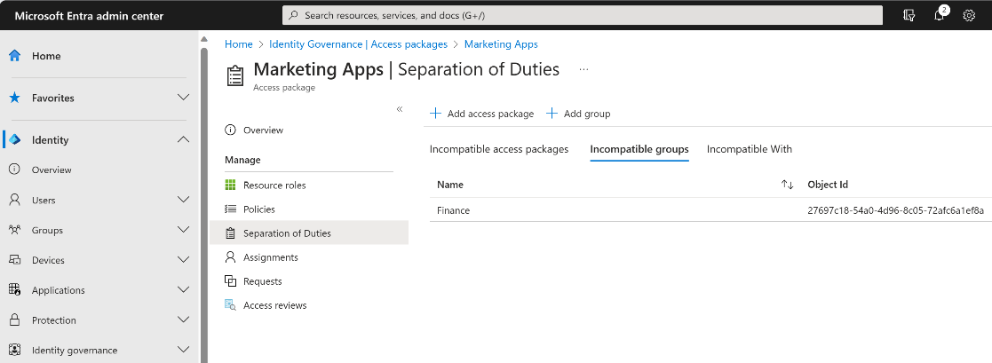


GRC checks and integrations
Built-in reports and separation of duties (SoD) checks
Provides reports and alerts on users who have incompatible access rights across entitlement management and groups
Restricts users from requesting an access package if it is incompatible with the user's existing access
GRC partners FastPath and Pathlock integrate with Microsoft Entra ID Governance to extend support for finer-grained separation of duties checks in additional business apps.
Microsoft Entra ID Governance
GRC partners
Additional ERP apps

Slide 17
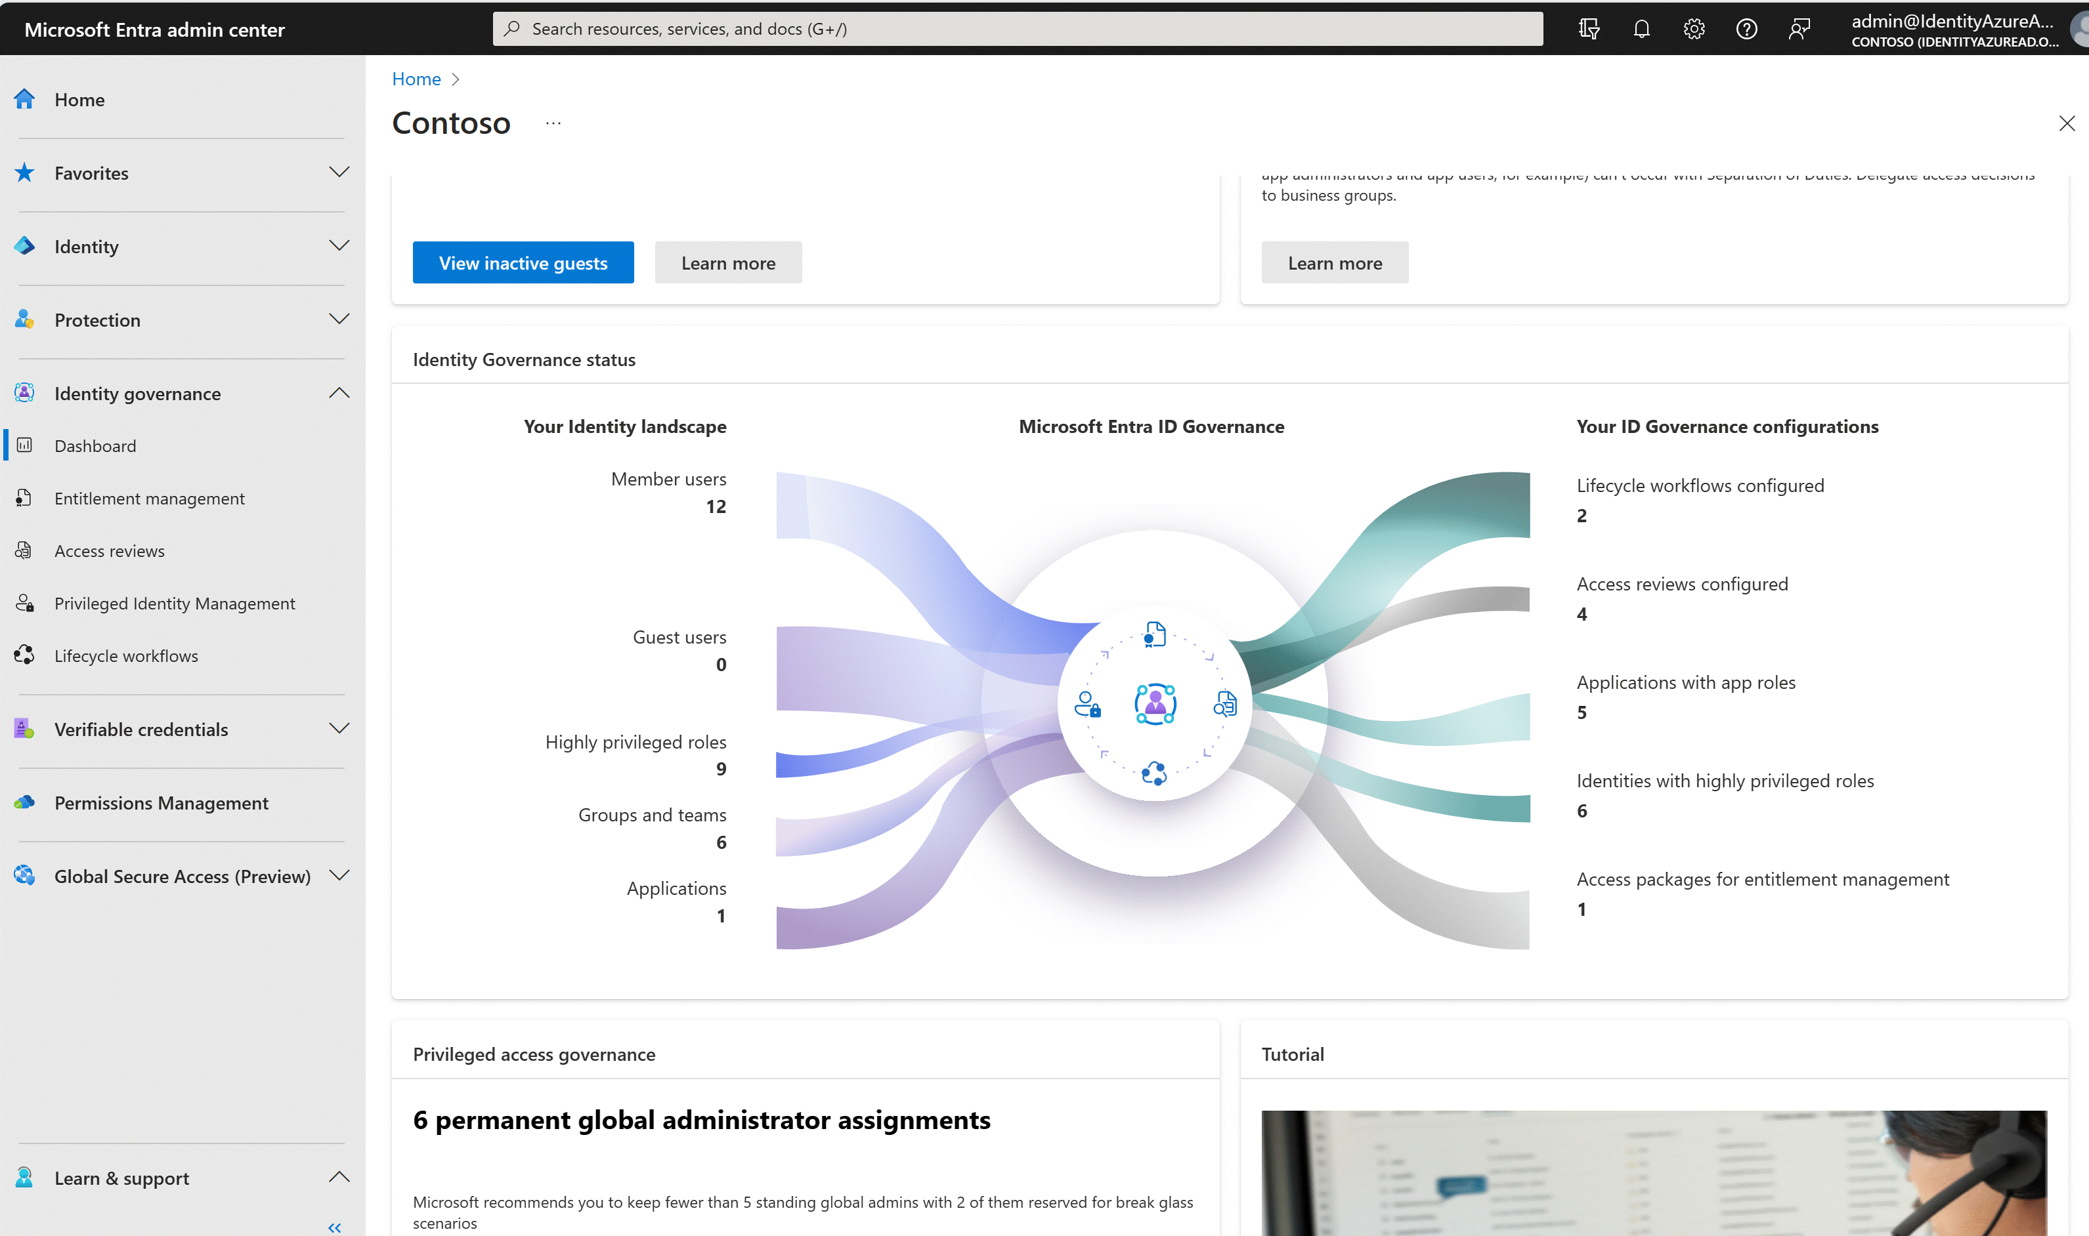
Actionable dashboard
Visual report of identity governance posture, with recommended actions
Understand the current environment
Quick links to graphical reporting
ML-based recommendations
Additional information at your fingertips

Slide 18
Feature to new sku mapping
New sku features that extend Access Reviews and Entitlement management
User-to-group affiliation
Inactive users
Access Reviews of PIM for Groups (Public Preview)
EM + Custom extensions
EM + Verified IDs
EM - Auto Assignment policies
EM - Invite + Assign Any
EM - Sponsors Policy

Slide 19
Microsoft Entra ID Governance
A premium identity governance product, built on the Microsoft Entra ID framework
Actionable Dashboard
Entitlement Management
Privileged Identity Management
Access Reviews
Microsoft Entra ID Premium Plan 2
capabilities
Microsoft Entra ID Governance
capabilities
Lifecycle Workflows
Access requests w/Verified IDs
ML access review recommendations

Slide 20
Microsoft Entra Identity Governance
Capability | Scenario | Feature
Identity lifecycle (employees) | Admins can enable user account provisioning from Workday or SuccessFactors cloud HR, or on-premises HR. | Cloud HR to Azure AD user provisioning
Identity lifecycle (guests) | Admins can enable self-service guest user onboarding from another Microsoft Entra tenant, direct federation, One Time Passcode (OTP) or Google accounts. Guest users are automatically provisioned and deprovisioned subject to lifecycle policies. | Entitlement management using B2B
Entitlement management | Resource owners can create access packages containing apps, Teams, Microsoft Entra, and Microsoft 365 groups, and SharePoint Online sites. | Entitlement management
Lifecycle Workflows | Admins can enable the automation of the lifecycle process based on user conditions. | Lifecycle Workflows
Access requests | End users can request group membership or application access. End users, including guests from other organizations, can request access to access packages. | Entitlement management
Workflow | Resource owners can define the approvers and escalation approvers for access requests and approvers for role activation requests. | Entitlement management and PIM
Policy and role management | Admin can define conditional access policies for run-time access to applications. Resource owners can define policies for user's access via access packages. | Conditional access and Entitlement management policies
Access certification | Admins can enable recurring access recertification for: SaaS apps, on-premises apps, cloud group memberships, Microsoft Entra, or Azure Resource role assignments. Automatically remove resource access, block guest access and delete guest accounts. | Access reviews, also surfaced in PIM
Fulfillment and provisioning | Automatic provisioning and deprovisioning into Microsoft Entra connected apps, including via SCIM, LDAP, SQL and into SharePoint Online sites. | User provisioning
Reporting and analytics | Admins can retrieve audit logs of recent user provisioning and sign on activity. Integration with Azure Monitor and 'who has access' via access packages. | Azure AD reports and monitoring
Privileged access | Just-in-time and scheduled access, alerting, approval workflows for Microsoft Entra roles (including custom roles) and Azure Resource roles. | Azure AD PIM
Auditing | Admins can be alerted of creation of admin accounts. | Azure AD PIM alerts
http://aka.ms/IdentityGovernanceOverview

Slide 21
Resources
Microsoft Entra ID Governance training hub aka.ms/EntraIDGovernanceTraining
Microsoft Entra identity blog aka.ms/IdentityBlog
Microsoft Entra product page aka.ms/entra/identitygovernance
Microsoft Identity solution page microsoft.com/Identity
Microsoft Entra technical documentation aka.ms/Entra/IDGovDocs
Try Microsoft Entra ID Governance free aka.ms/EntraIDGovTrial
Entra ID Governance Licensing Fundamentals
https://aka.ms/EntraIG/LicDocs

Slide 22
Resources (Continued)
Interactive Guides (https://aka.ms/EntraIDGovGuides). These are click-through demos that follow a single path through a scenario, with some popup callouts, that run in a browser. There are currently four scenarios, with two more in progress.
CDX demo with ID Governance trial (https://cdx.transform.microsoft.com/ for demo pre-populated one year or 90-day M365 tenant; https://aka.ms/EntraIDGovTrial to enable ID Governance trial). Fully functional M365 enterprise tenant with content, and a 30-day trial of ID Governance.
CDX demo with ID Governance demo (https://cdx.transform.microsoft.com/ for demo pre-populated one year or 90-day M365 tenant, with a checkbox to add one year of ID Governance. Fully functional M365 enterprise tenant with content, and fully functional ID Governance.

